Slide 1
GCAM Assignment #2
ITM 20235575 안지석

Slide 2
Intro
I ran three different scenarios(Reference, cap, tax) using the given material for GCAM assignment 2.
To plot the results, used R library called gcamextractor.
After data is imported to R with gcamextractor, wrote a function to plot results for different parameters.

Slide 3
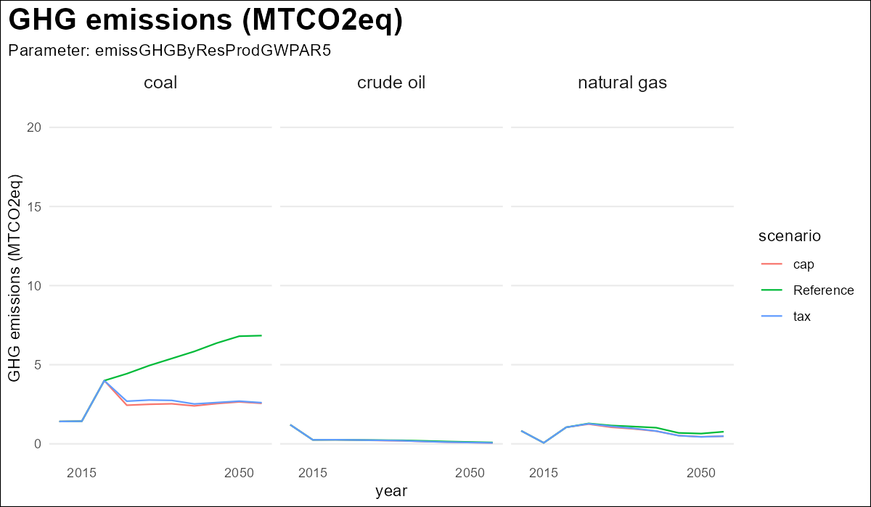
Where do CO2 emission reductions come from?
Compared to Reference scenario, cap and scenario showed that GHG emission from coal declines.

Slide 4
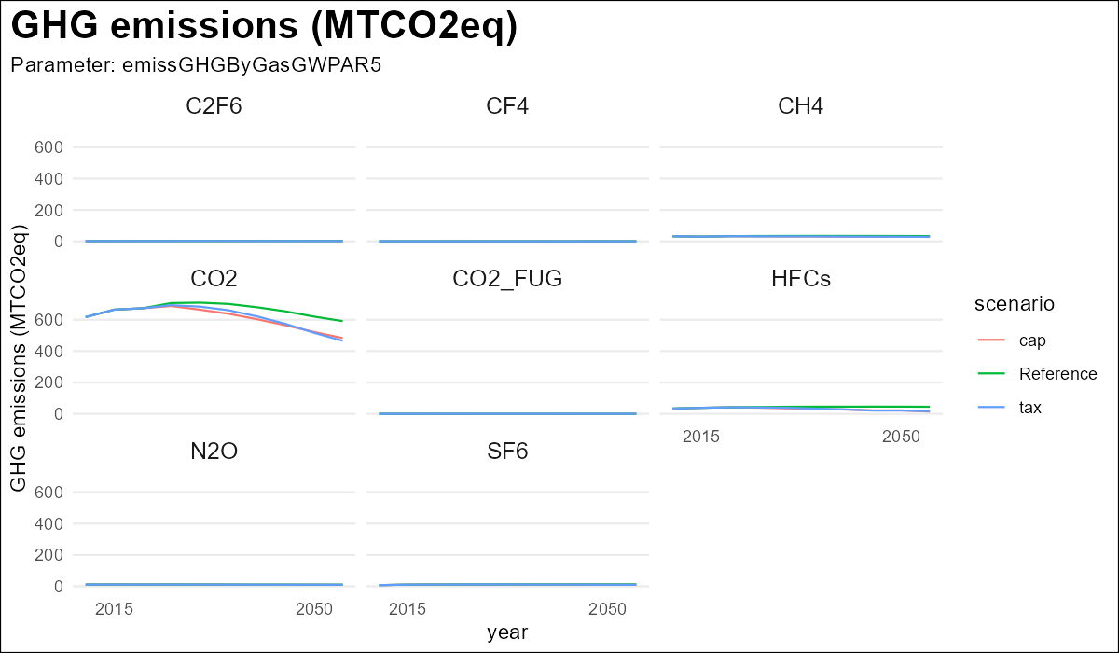
Where do CO2 emission reductions come from?
In cap and tax scenario, CO2 emission declined.

Slide 5
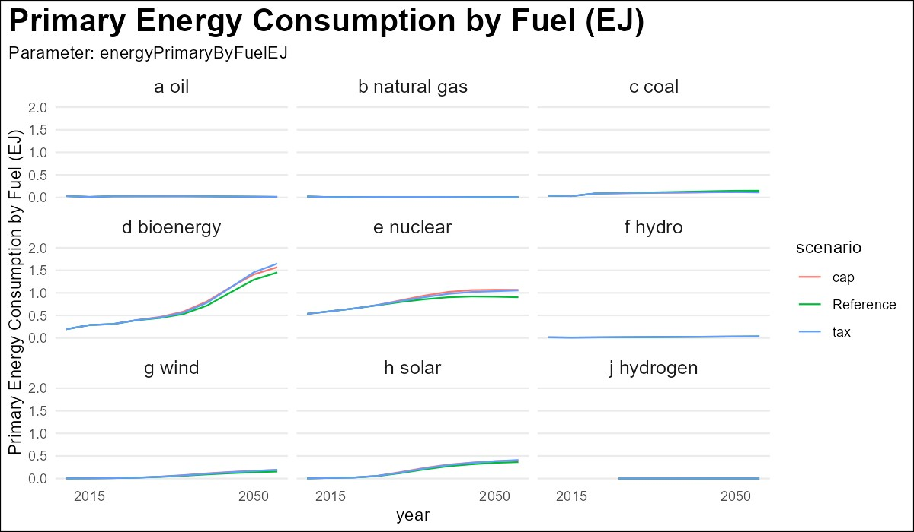
How is energy supply decarbonized?
Primary energy consumption from bioenergy and nuclear in cap and tax scenario increased.

Slide 6
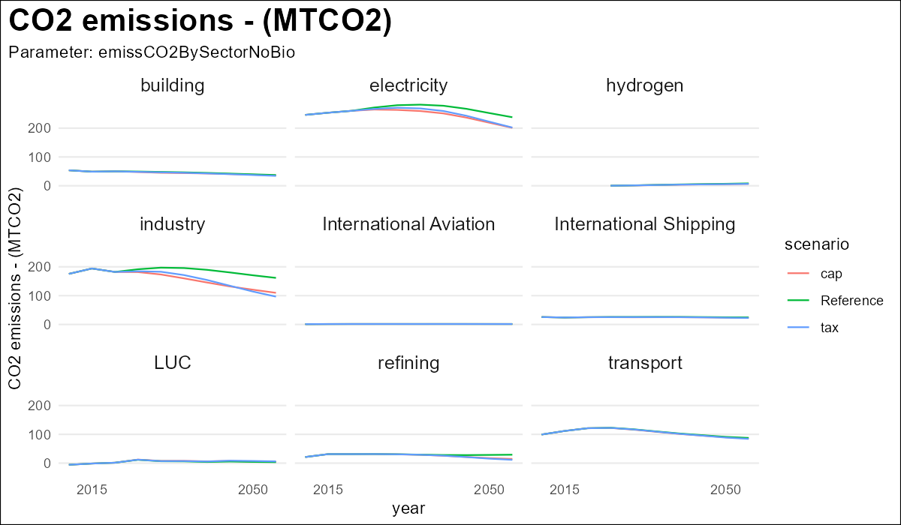
How are the end-use sectors decarbonized?
Major CO2 emission sectors like electricity and industry showed emission decline. But transport sector has no differences.

Slide 7
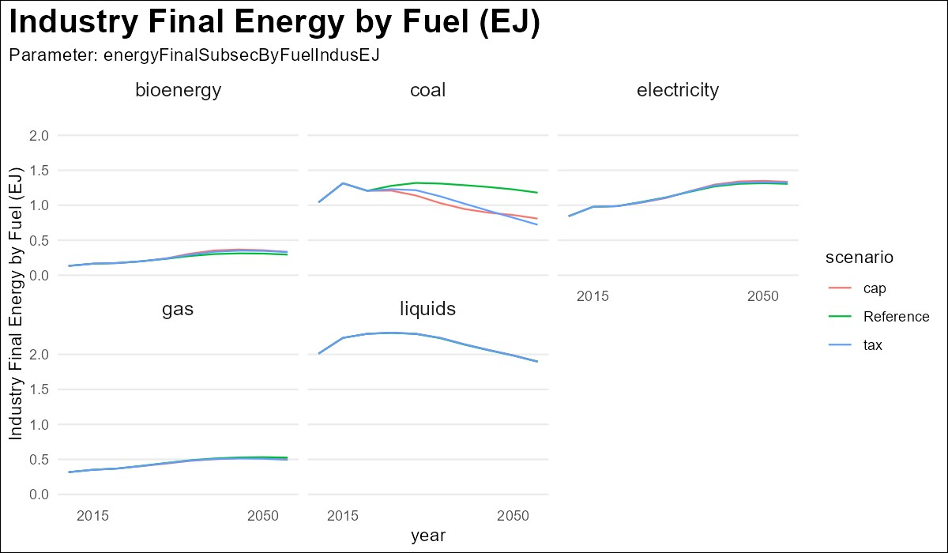
How does total energy consumption in each sector change?
Final energy consumption by coal declined.

Slide 8
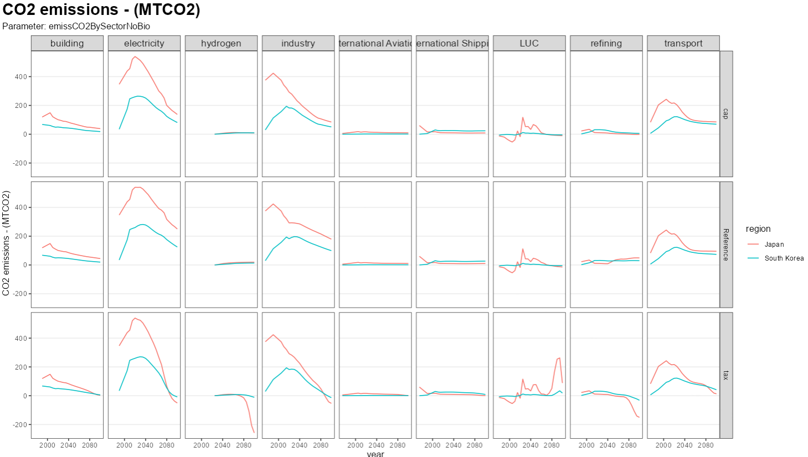
Are the decarbonization strategies different between the two regions?
Comparison between South Korea and Japan. In tax scenario, Japan shows negative CO2 emission from hydrogen and refining. From what technology???

